Slide 1

CS4055- Digital Image Processing
Digital Imaging Fundamentals

Slide 2

Contents
This lecture will cover:
The human visual system
Light and the electromagnetic spectrum
Image representation
Image sensing and acquisition
Sampling, quantisation and resolution
Some basic relationships between pixels
Linear and nonlinear operations

Slide 3

Human Visual System
The best vision model we have!
Knowledge of how images form in the eye can help us with processing digital images.
We will take just a whirlwind tour of the human visual system.

Slide 4
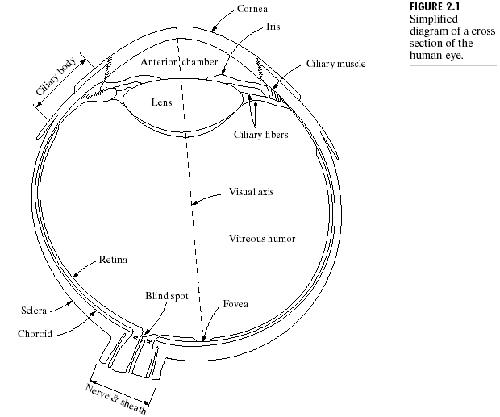

Structure Of The Human Eye
Notes:
Cornea and sclera keep everything in!
The choroid contains all of the blood vessels that serve as nutrition to the eye
The iris contains the pigment that gives our eyes their colour
Rods for general vison cones for details
Blind spot is where the optic nerve connects
BLIND SPOT EXPERIMENT
Women have extra cones which means they can see more colours

Slide 5
Structure Of The Human Eye
The lens focuses light from objects onto the retina
The retina is covered with light receptors called cones (6-7 million) and rods (75-150 million)
Cones are concentrated around the fovea and are very sensitive to colour
Rods are more spread out and are sensitive to low levels of illumination
Notes:
Cornea and sclera keep everything in!
The choroid contains all of the blood vessels that serve as nutrition to the eye
The iris contains the pigment that gives our eyes their colour
Rods for general vison cones for details
Blind spot is where the optic nerve connects
BLIND SPOT EXPERIMENT
Women have extra cones which means they can see more colours

Slide 6
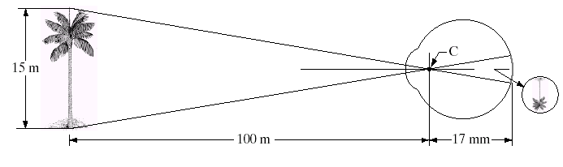
Image Formation In The Eye
Muscles (Iris) within the eye can be used to change the shape of the lens allowing us focus on objects that are near or far away
An image is focused onto the retina causing rods and cones to become excited which ultimately send signals to the brain

Slide 7

Blind-Spot Experiment
Draw an image similar to that below on a piece of paper (the dot and cross are about 6 inches apart)
Close your right eye and focus on the cross with your left eye
Hold the image about 20 inches away from your face and move it slowly towards you
The dot should disappear!
Notes:
What happened when the circle disappeared? Did you see nothing where the circle had been? No, when the circle disappeared, you saw a plain white background that matched the rest of the sheet of paper. This is because your brain "filled in" for the blind spot - your eye didn't send any information about that part of the paper, so the brain just made the "hole" match the rest. Try the experiment again on a piece of colored paper. When the circle disappears, the brain will fill in whatever color matches the rest of the paper.

Slide 8
Brightness Adaptation & Discrimination
The human visual system can perceive approximately 10¹⁰ different light intensity levels
However, at any one time we can only discriminate between a much smaller number – brightness adaptation
Similarly, the perceived intensity of a region is related to the light intensities of the regions surrounding it this is called Simultaneous contrast.

Slide 9

Brightness Adaptation & Discrimination (cont…)
Notes:
Mach bands were named after Ernst Mach who described the phenomenon in 1865

Slide 10

Brightness Adaptation & Discrimination (cont…)
Notes:
Mach bands were named after Ernst Mach who described the phenomenon in 1865

Slide 11
2. Brightness Adaptation & Discrimination (cont…)
For human visual system the perceived brightness is not a simple function of intensity.
It is based on the fact that the visual system tends to undershoot or overshoot around the boundary of regions of different intensities.
Notes:
Mach bands were named after Ernst Mach who described the phenomenon in 1865

Slide 12

Simultaneous Contrast
Notes:
Mach bands were named after Ernst Mach who described the phenomenon in 1865

Slide 13
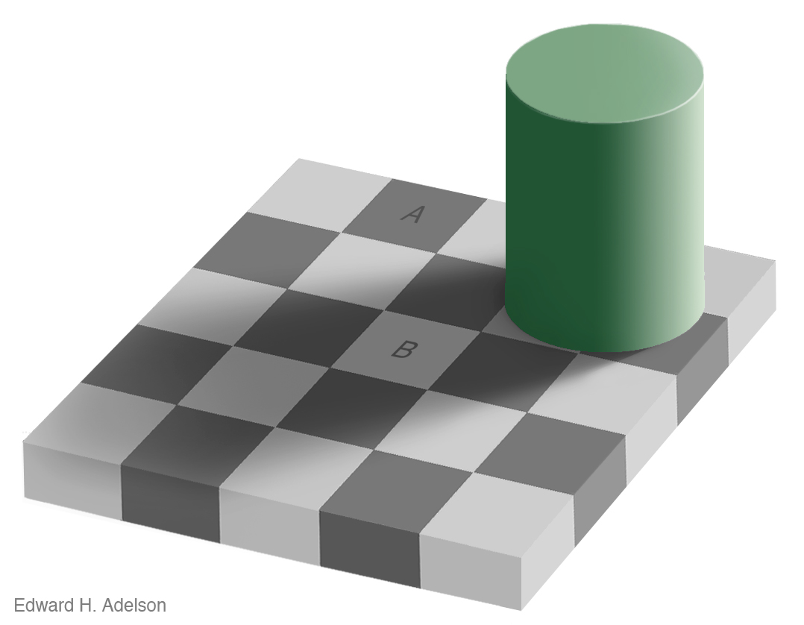
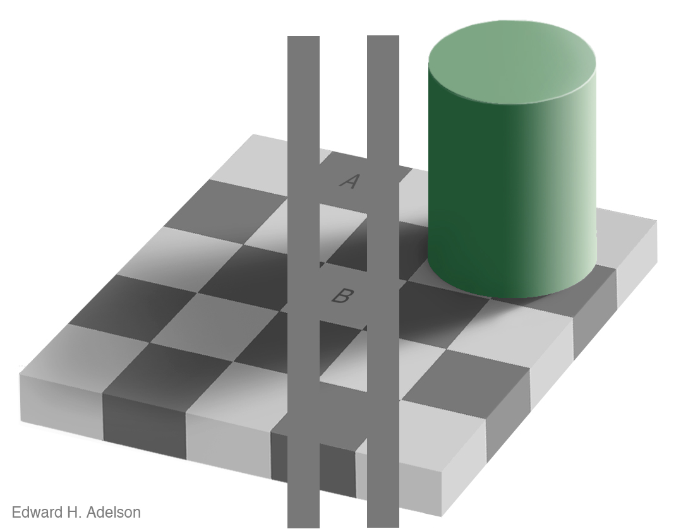
Simultaneous Contrast
Notes:
Mach bands were named after Ernst Mach who described the phenomenon in 1865

Slide 14
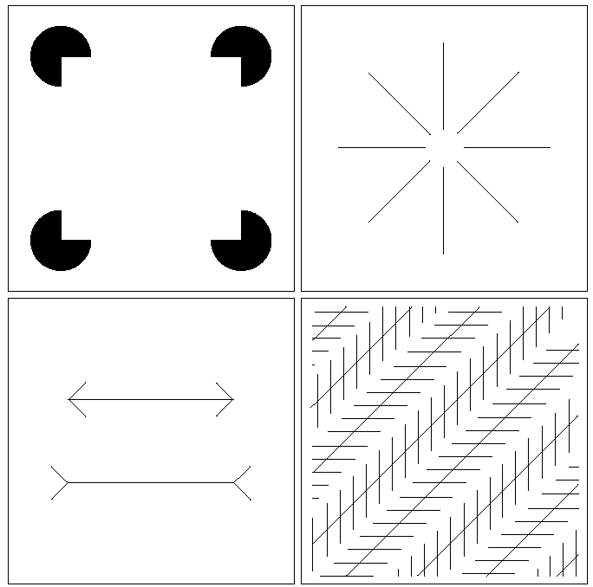
Optical Illusions
Our visual systems play lots of interesting tricks on us

Slide 15
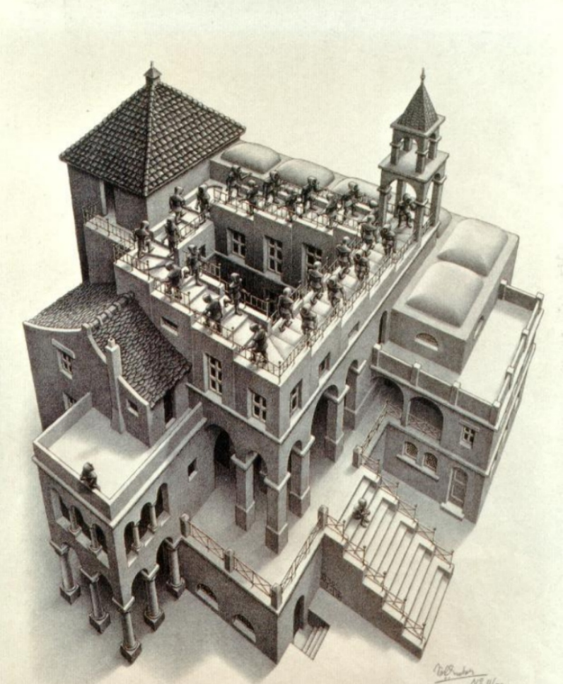
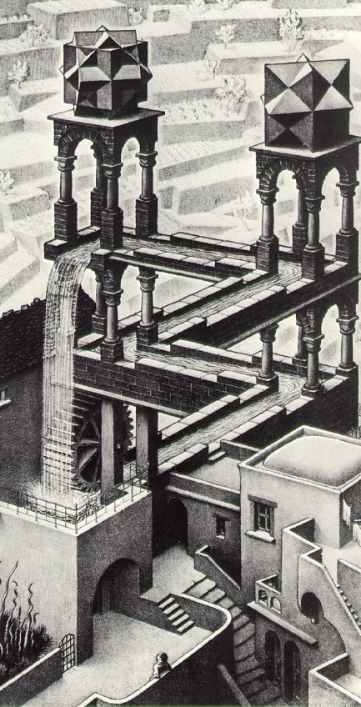
Optical Illusions (cont…)

Slide 16
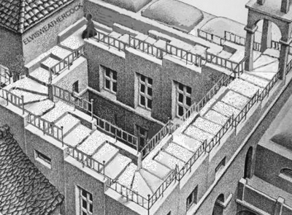
Optical Illusions (cont…)

Slide 17
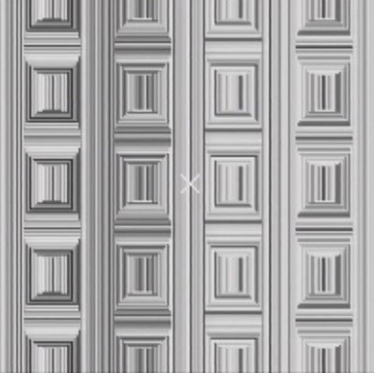
Optical Illusions (cont…)
Do at home illusion
Stare at the cross in the middle of the image and think circles

Slide 18
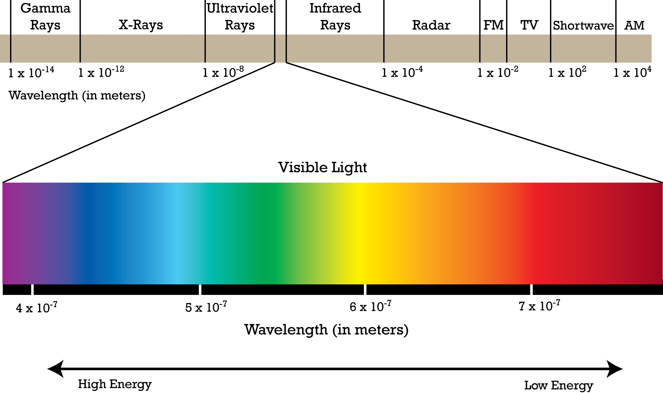
Electromagnetic Spectrum
This Photo by Unknown author is licensed under CC BY-NC-ND.
Light

Slide 19

Light And The Electromagnetic Spectrum
In 1666 Sir Isaac Newton discovered that light passed through a prism splits into a continuous spectrum of colour.
Many image applications use electromagnetic radiation that is far outside the visual spectrum – x-ray images, infra-red images etc.
Light is just a particular part of the electromagnetic spectrum that can be sensed by the human eye.
The electromagnetic spectrum is split up according to the wavelengths of different forms of energy.
Notes:
In 1666 Sir Isaac Newton discovered that light passed through a prism splits into a continuous spectrum of colours
Many image applications use electromagnetic radiation that is far outside the visual spectrum – x-ray images, infra-red images – we genrate images of these images by mapping them to the visual spectrum.
Frequency is the number of occurrences of a repeating event per unit time.

Slide 20
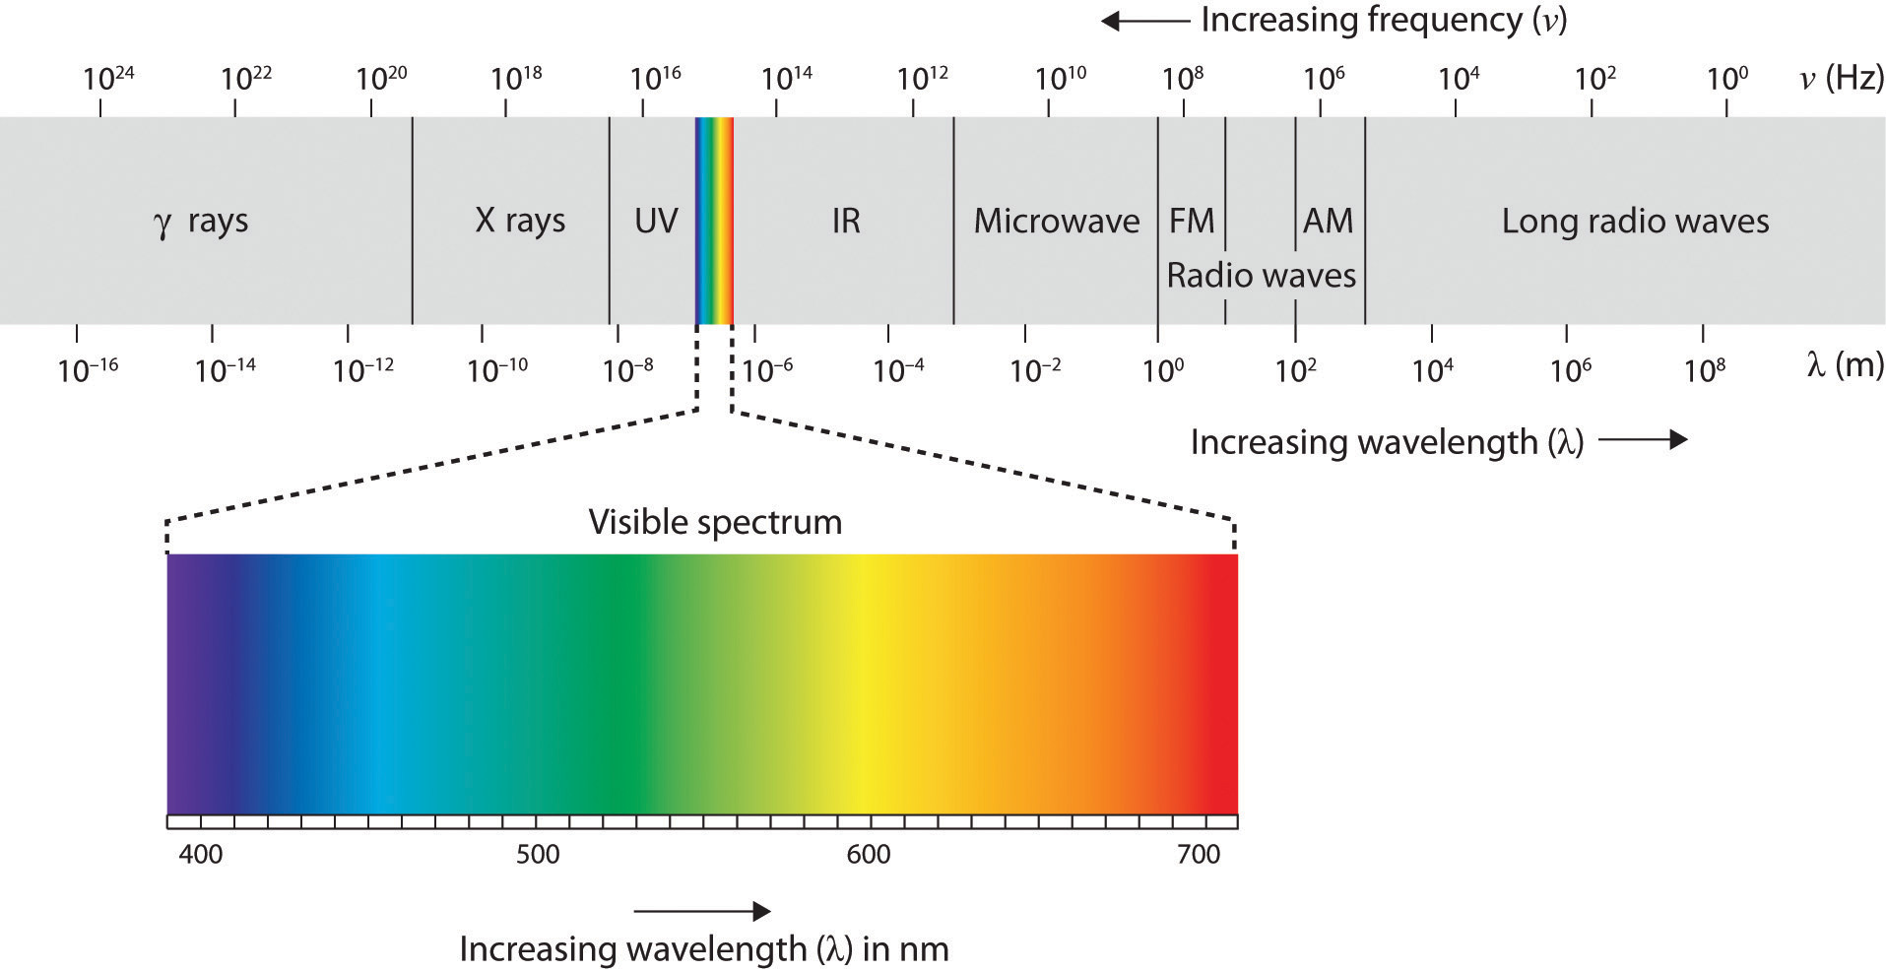
Electromagnetic Spectrum
Frequency of 4 × 10¹⁴ to 8 × 10¹⁴ cycles per second, or hertz (Hz)

Slide 21
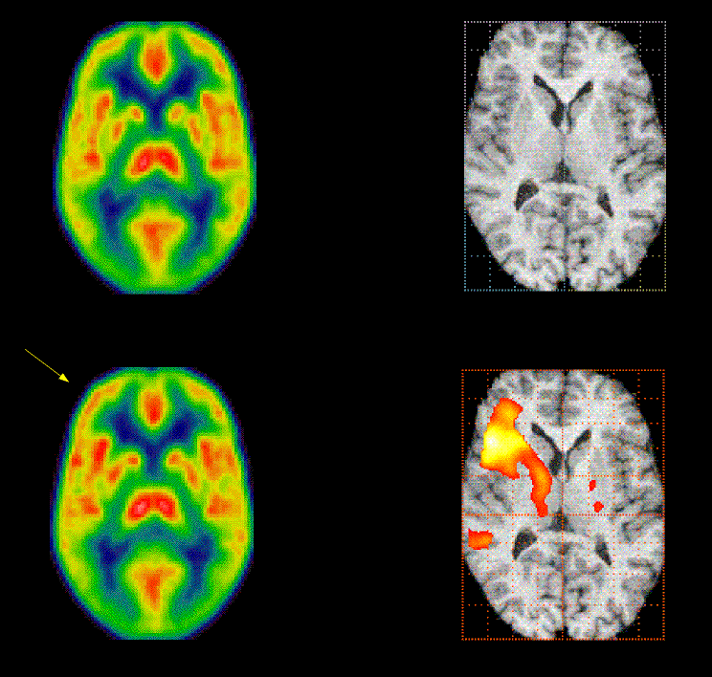
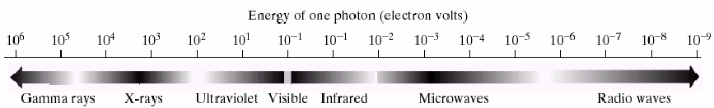
Positron Emission Tomography (PET) Images
Operate in gamma-ray frequency
Notes:
Positron Emission Tomography (PET) Images are a type of medical imaging technique that utilizes radioactive tracers to produce detailed images of the internal structures and functions of the body. These images are generated by detecting the gamma rays emitted by positron-emitting radionuclides introduced into the body. PET scans are commonly used in various medical fields, including oncology, neurology, cardiology, and more, to visualize metabolic processes and identify abnormalities at a cellular level. The images provide valuable insights into the functioning of organs and tissues, aiding in disease diagnosis, treatment planning, and monitoring of patient progress.

Slide 22
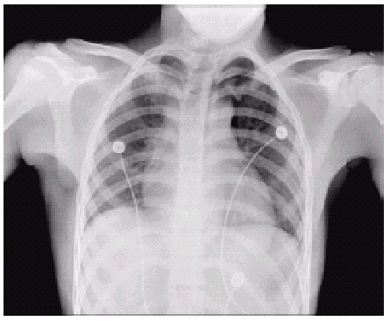
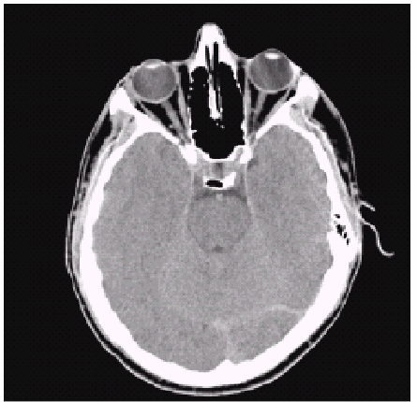
X-RAY Imaging
Operate in X-ray frequency
chest
head

Slide 23
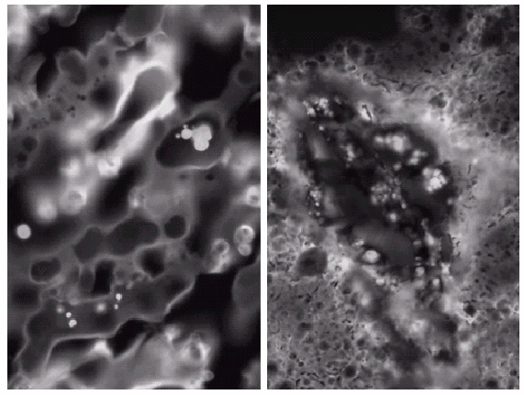
Fluoresense Microscopy
Operate in ultraviolet frequency
normal corn
smut corn
Notes:
Fluorescence Microscopy is a powerful imaging technique used in various scientific fields, especially in biology and materials science. It involves the use of fluorescent dyes or proteins that emit light of a specific color when exposed to specific wavelengths of light.

Slide 24
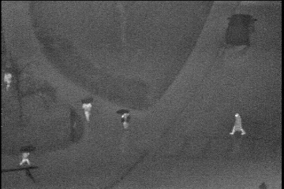
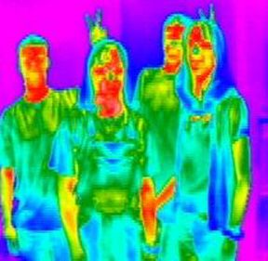
Thermal Imaging
Operate in infrared frequency
Grayscale representation
(bright pixels correlate with
high-temperature regions)
Pseudo-color representation
(Human body dispersing
heat denoted by red)

Slide 25
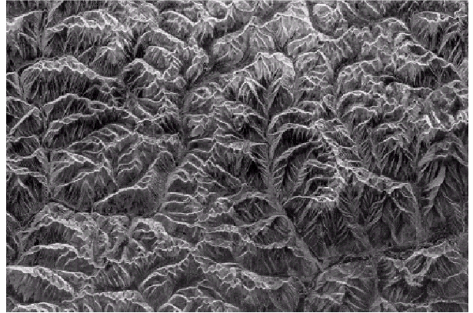
Radar Imaging
Operate in microwave frequency
Mountains in Southeast Tibet

Slide 26
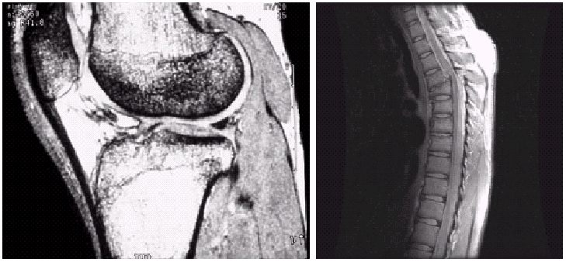
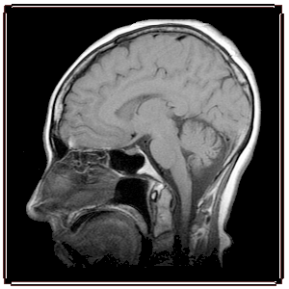
Magnetic Resonance Imaging (MRI)
Operate in radio frequency
knee
spine
head

Slide 27

Sampling, Quantisation And Resolution
In the following slides we will consider what is involved in capturing a digital image of a real-world scene:
Image sensing and representation
Sampling and quantisation
Resolution

Slide 28
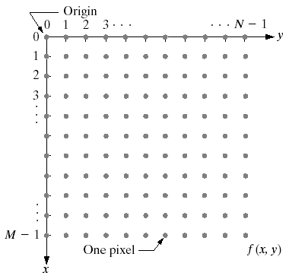
Image Representation
Before we discuss image acquisition recall that a digital image is composed of M rows and N columns of pixels each storing a value.
Pixel values are most often grey levels in the range 0-255(black-white).
We will see later on that images can easily be represented as matrices
col
f (row, col)
row

Slide 29

Image Acquisition
Images are typically generated by illuminating a scene and absorbing the energy reflected by the objects in that scene
Typical notions of illumination and scene can be way off:
X-rays of a skeleton
Ultrasound of an unborn baby
Electro-microscopic images of molecules

Slide 30
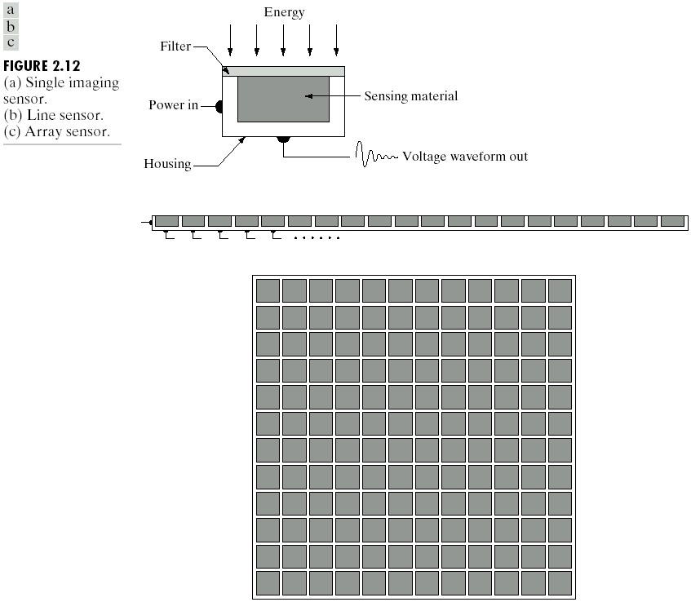
Image Sensing
Incoming energy lands on a sensor material responsive to that type of energy and this generates a voltage
Collections of sensors are arranged to capture images
Imaging Sensor
Line of Image Sensors
Array of Image Sensors

Slide 31
Image Sensing
Using Sensor Strips and Rings

Slide 32
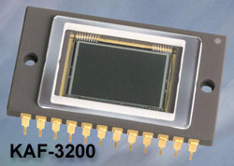
Charge-Coupled Device (CCD)
w Used to convert a continuous
image into a digital image
w Contains an array of light sensors
w Converts photon into electric charges accumulated in each sensor unit
E = h * f
Plank’s Constant
h = 6.62606957 × 10⁻³⁴
CCD KAF-3200E from Kodak.
(2184 x 1472 pixels,
Pixel size 6.8 microns²) (1 micron= 10⁻⁶m)
Notes:
A charge-coupled device (CCD) is an integrated circuit containing an array of linked, or coupled, capacitors. Under the control of an external circuit, each capacitor can transfer its electric charge to a neighboring capacitor. CCD sensors are a major technology used in digital imaging. In a CCD image sensor, pixels are represented by p-doped metal–oxide–semiconductor (MOS) capacitors.
In applications with less exacting quality demands, such as consumer and professional digital cameras, active pixel sensors, also known as CMOS sensors (complementary MOS sensors), are generally used. However, the large quality advantage CCDs enjoyed early on has narrowed over time and since the late 2010s CMOS sensors are the dominant technology, having largely if not completely replaced CCD image sensors.

Slide 33
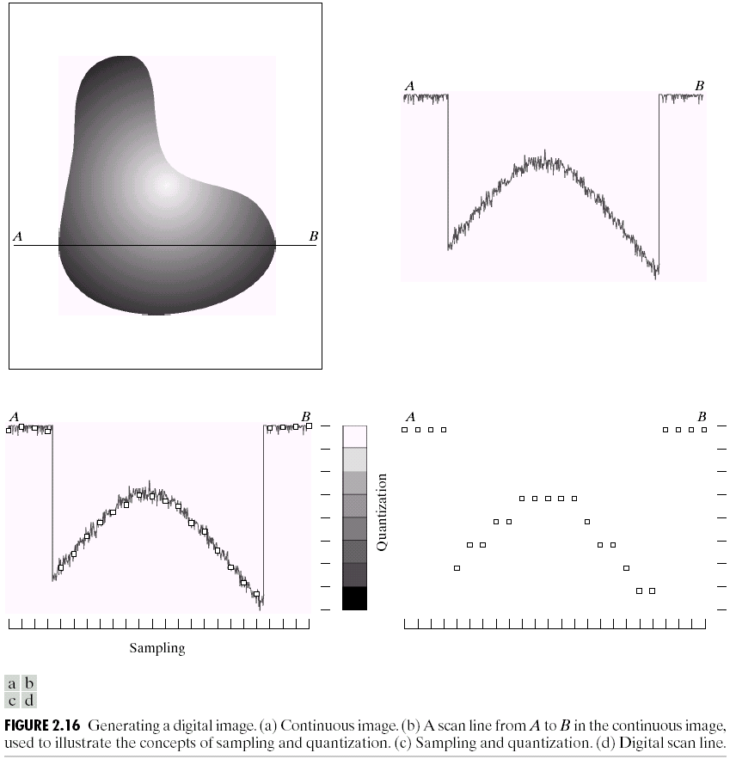
Image Sampling And Quantization
A digital sensor can only measure a limited number of samples at a discrete set of energy levels
Sampling & Quantization are the processes of converting a continuous analogue signal into a digital representation of this signal
Notes:
Analogue Vs digital
Think of the volume knob on your stereo
Records Vs CDs Vs Mp3s
Nyquist theory etc talks about how much sampling we need to do

Slide 34
Sampling
Quantization
Signal Amplitude
Billion of frequencies are falling on the object and we sample to get only few
Coordinate Values

Slide 35
Image Sampling And Quantization
An image may be continuous with respect to the x- and y-coordinates, and also in amplitude. To convert it to digital form, we have to sample the function in both coordinates and in amplitude. Digitizing the coordinate values is called sampling. Digitizing the amplitude values is called quantization.
Notes:
Billion of frequencies are falling on the object and we sample to get only few

Slide 36

Image Sampling And Quantization (cont…)
Remember that a digital image is always only an approximation of a real world scene

Slide 37
Image Representation

Slide 38
Image Representation

Slide 39
Image Representation

Slide 40
Image Representation

Slide 41
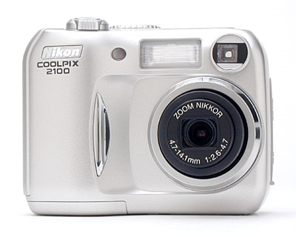
Spatial Resolution
The spatial resolution of an image is determined by how sampling was carried out.
Spatial resolution simply refers to the smallest discernable detail in an image
Vision specialists will often talk about pixel size
Graphic designers will talk about dots per inch (DPI)

Slide 42
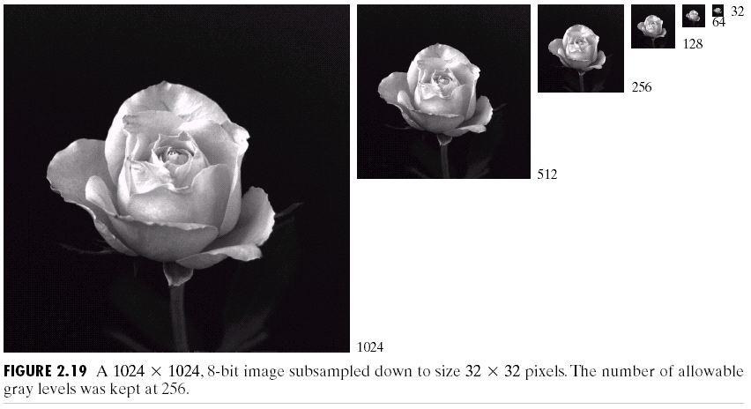
Spatial Resolution (cont…)

Slide 43
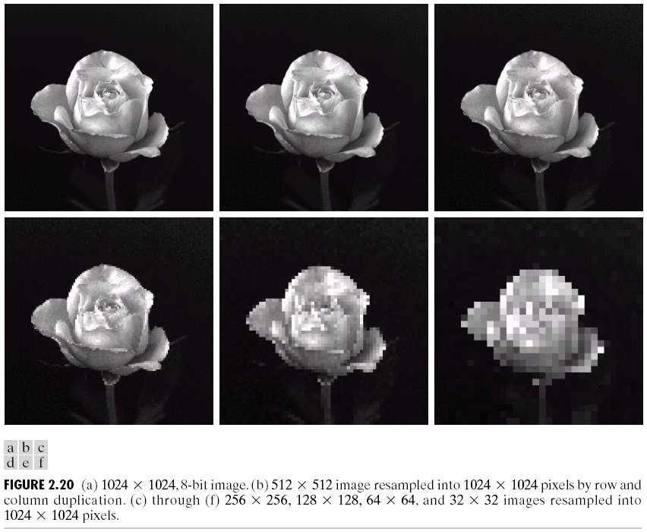
Spatial Resolution (cont…)
Resolution: 1024x1024

Slide 44
Spatial Resolution (cont…)
Resolution: 512x512

Slide 45
Spatial Resolution (cont…)
Resolution: 256x256

Slide 46
Spatial Resolution (cont…)
Resolution: 128x128

Slide 47
Spatial Resolution (cont…)
Resolution: 64x64

Slide 48
Spatial Resolution (cont…)
Resolution: 32x32

Slide 49
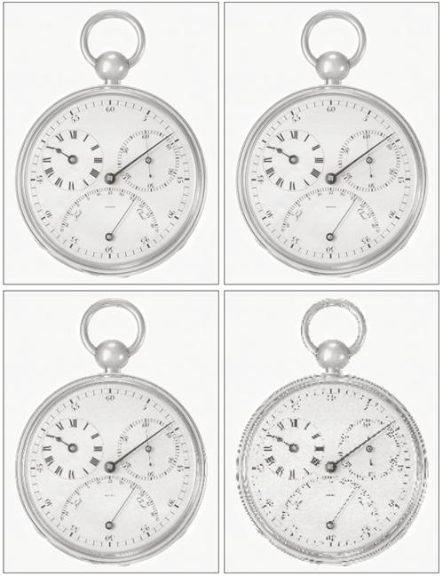
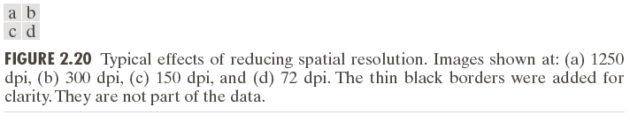
Spatial Resolution (cont…)
Resolution: dots (pixels) per unit distance
dpi: dots per inch

Slide 50
Intensity Level Resolution
Intensity level resolution refers to the number of intensity levels used to represent the image
The more intensity levels used, the finer the level of detail discernable in an image
Intensity level resolution is usually given in terms of the number of bits used to store each intensity level
Number of Bits
Number of Intensity Levels
Examples
1
2
0, 1
2
4
00, 01, 10, 11
4
16
0000, 0101, 1111
8
256
00110011, 01010101
16
65,536
1010101010101010

Slide 51
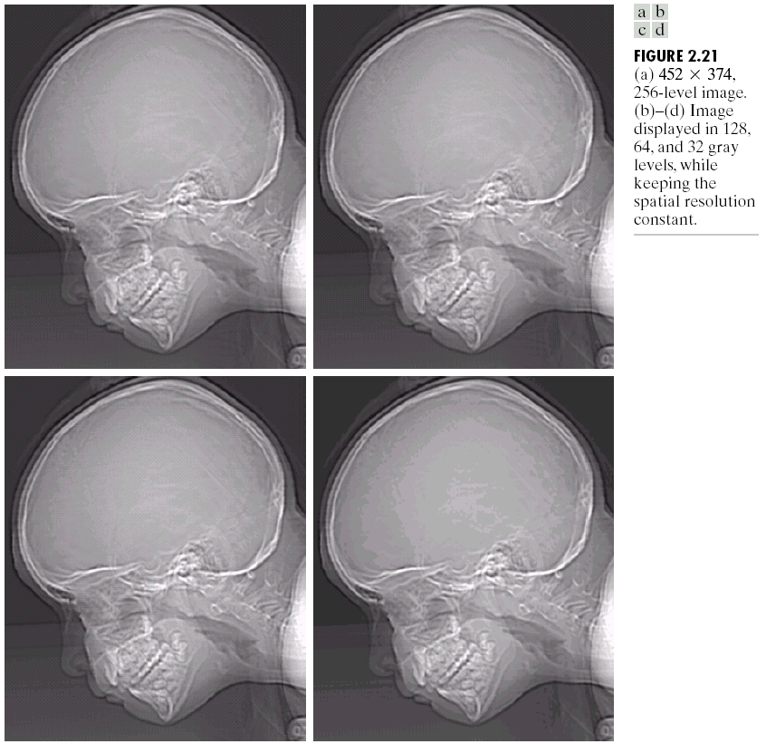
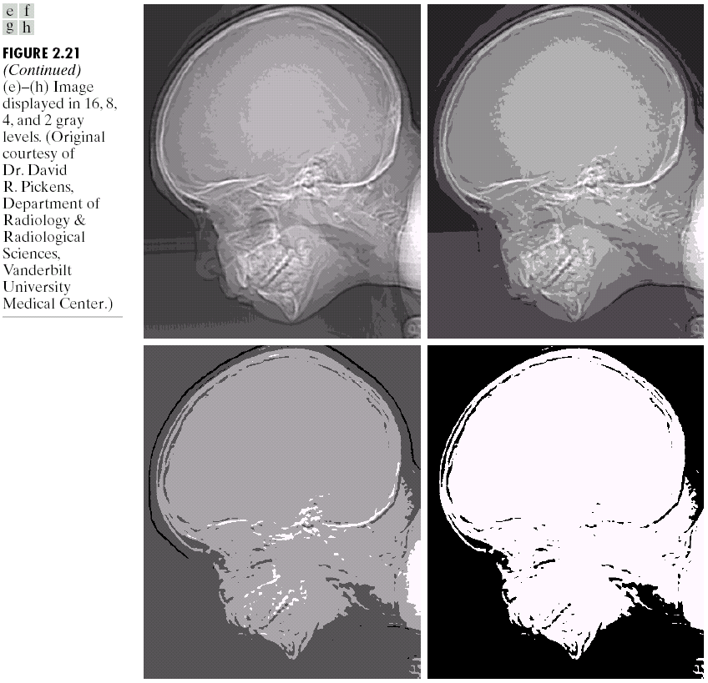
Intensity Level Resolution (cont…)
256 grey levels (8 bits per pixel)
128 grey levels (7 bpp)
64 grey levels (6 bpp)
32 grey levels (5 bpp)
16 grey levels (4 bpp)
8 grey levels (3 bpp)
4 grey levels (2 bpp)
2 grey levels (1 bpp)

Slide 52
Intensity Level Resolution (cont…)
Resolution: 8bpp (i.e., 256 Grey Levels)

Slide 53
Intensity Level Resolution (cont…)
Resolution: 7bpp (i.e., 128 Grey Levels)

Slide 54
Intensity Level Resolution (cont…)
Resolution: 6bpp (i.e., 64 Grey Levels)

Slide 55
Intensity Level Resolution (cont…)
Notice False Contouring
Resolution: 5bpp (i.e., 32 Grey Levels)

Slide 56
Intensity Level Resolution (cont…)
False Contouring becomes more prominent as you decrease bit levels
Resolution: 4bpp (i.e., 16 Grey Levels)

Slide 57
Intensity Level Resolution (cont…)
Resolution: 3bpp (i.e., 8 Grey Levels)

Slide 58
Intensity Level Resolution (cont…)
Resolution: 2bpp (i.e., 4 Grey Levels)

Slide 59
Intensity Level Resolution (cont…)
Resolution: 1bpp (i.e., 2 Grey Levels) also called a binary image.

Slide 60
Image Representation
Digital image
M × N array
# bits to store : b = M × N × k bits
L discrete intensities – power of 2
L = 2^{k}
Integers in the interval [0, L - 1]
Dynamic range is the range of tonal difference between the lightest and darkest light of an image.
If low: image has a dull, washed-out gray look.
Contrast: difference between highest and lowest intensity
If high: Images are visually appealing.

Slide 61
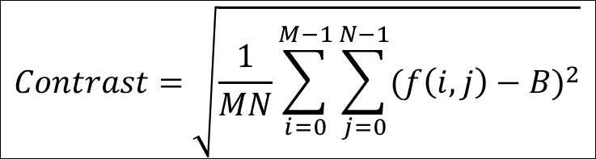
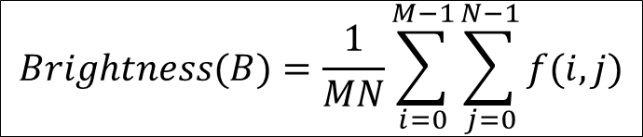
Brightness & Contrast
Brightness is a relative term. It depends on your visual perception. Brightness comes into picture when we try to compare with a reference.
Contrast is the variation in intensity levels of an image. When the Dynamic range of an image covers all available range of the imaging system then the image exhibits high contrast.
$$Contrast=\sqrt{\frac{1}{MN}\sum_{i=0}^{M−1}{\sum_{j=0}^{N−1}{{(f\left(i,j\right)−B)}^{2}}}}$$
$$Brightness(B)=\frac{1}{MN}\sum_{i=0}^{M−1}{\sum_{j=0}^{N−1}{f(i,j)}}$$

Slide 62
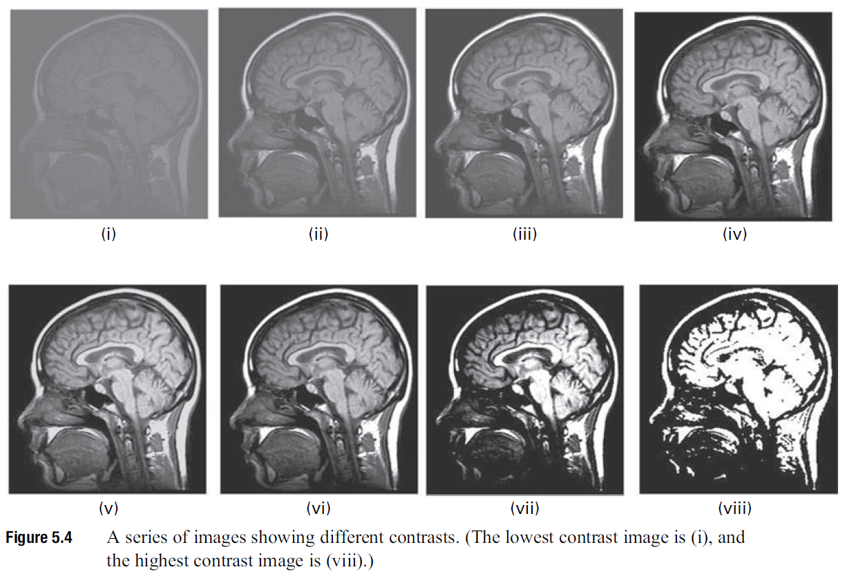
Contrast Examples

Slide 63
Image Histograms
The histogram of an image shows us the distribution of grey levels in the image
Massively useful in image processing, especially in segmentation
Frequencies
Grey Levels

Slide 64
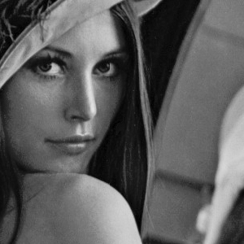
Histogram Examples

Slide 65
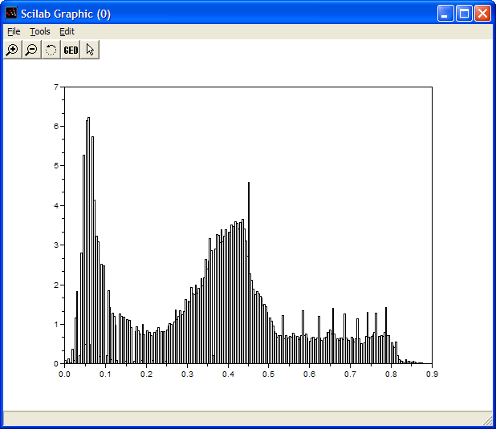
Histogram Examples (cont…)

Slide 66

Histogram Examples (cont…)

Slide 67
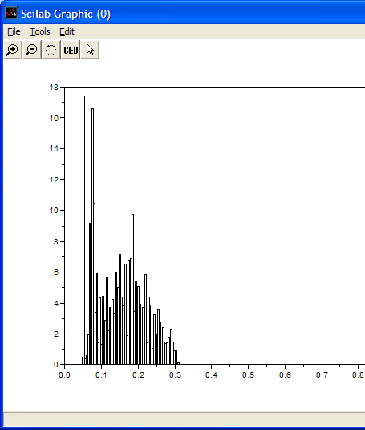
Histogram Examples (cont…)

Slide 68
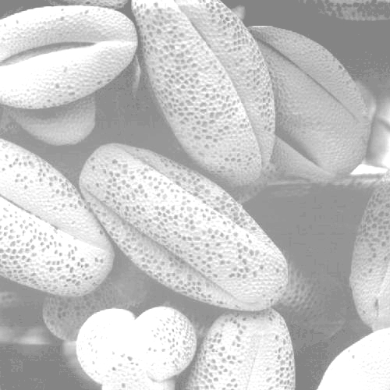
Histogram Examples (cont…)

Slide 69
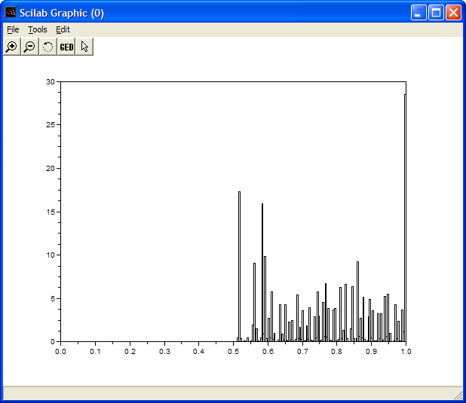
Histogram Examples (cont…)

Slide 70

Histogram Examples (cont…)

Slide 71
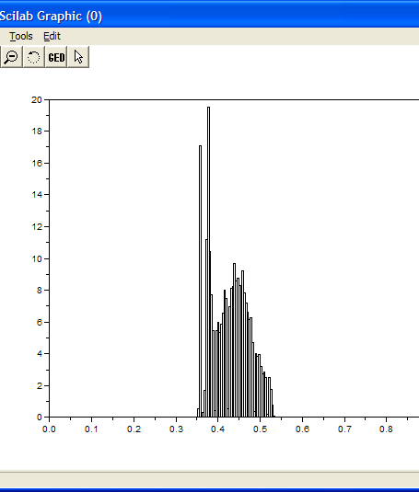
Histogram Examples (cont…)

Slide 72
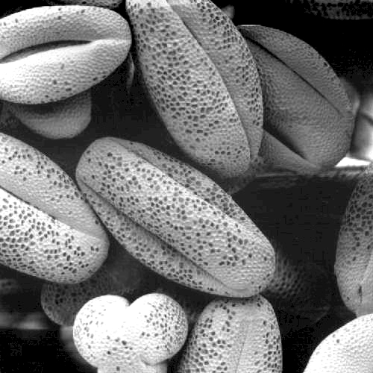
Histogram Examples (cont…)

Slide 73
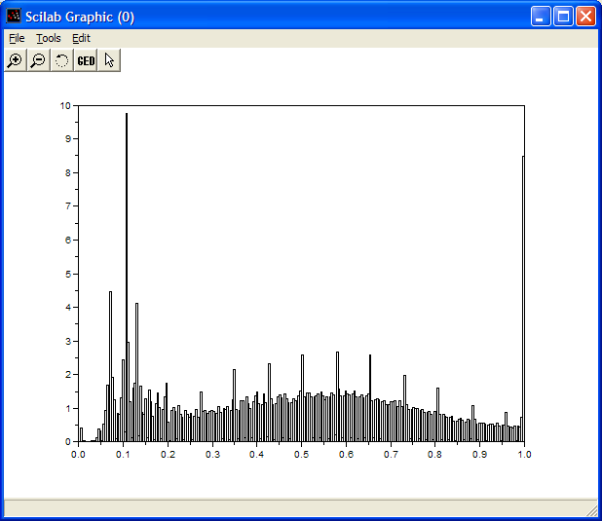
Histogram Examples (cont…)

Slide 74
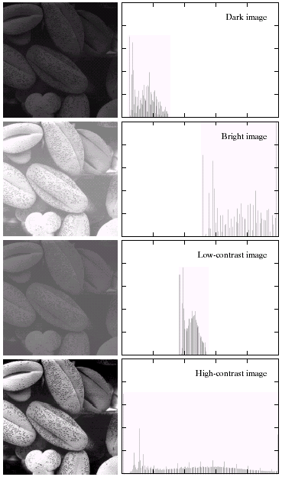
Histogram Examples (cont…)
A selection of images and their histograms
Notice the relationships between the images and their histograms
Note that the high contrast image has the most evenly spaced histogram

Slide 75
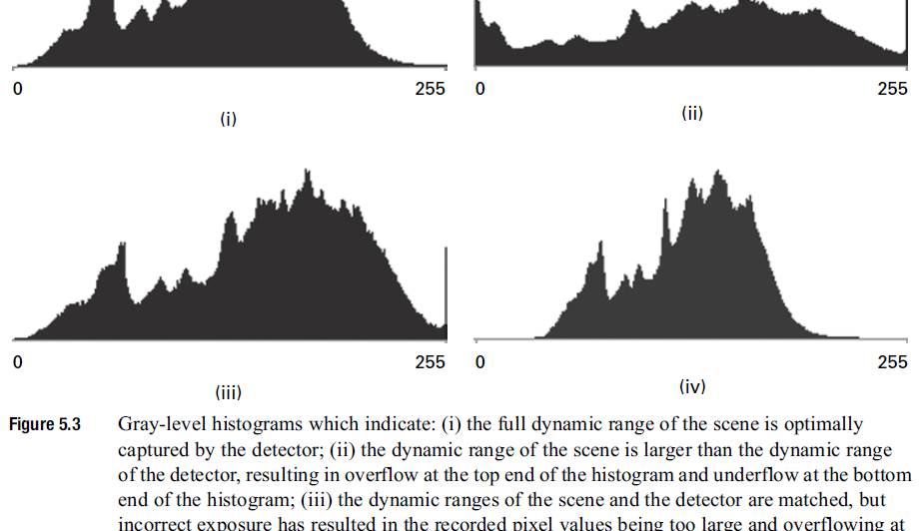
Dynamic Range (Scene vs Detector)

Slide 76
Saturation & Noise
Region with small variations in brightness
Noise is an unwanted signal that exists in electronic systems
In imaging, saturation is a type of distortion where the recorded image (or region) is limited to some maximum value, interfering with the measurement of bright regions of the scene.
Notes:
In the context of Dynamic Range. The chosen dynamic range can’t render small variations in brightness.

Slide 77

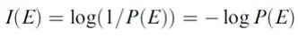
Entropy
Entropy is a measure of the amount of disorder or randomness in a system.
For images entropy measures the average global information content of the image in bits per pixel.
In information theory the information content of a single message state in units of information is given by:
Where P(E) is the prior probability of the occurrence of a message and I(E) is the amount of information in the message.
Notes:
Example of saying “Hello” again and again. It will have less information content.

Slide 78
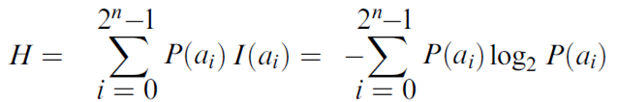
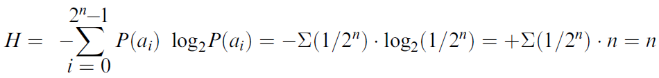
Entropy (cont..)
In an image, the pixel values, a_{i}, occur with probabilities P(a_{i}), which are given by the bin heights of the normalized histogram; the available pixel values run from 0 to 2^{n}–1.
A first-order estimate of the entropy, H, of an image is given by the sum of the information content of each pixel:

Slide 79
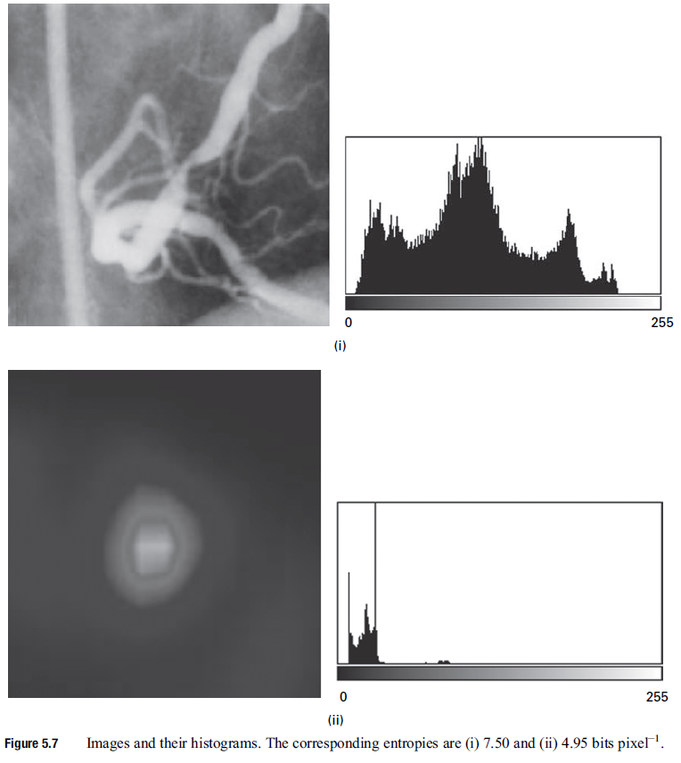
Entropy Example
High Contrast and High Entropy
Low Contrast and Low Entropy

Slide 80

Resolution: How Much Is Enough?
The big question with resolution is always how much is enough?
This all depends on what is in the image and what you would like to do with it
Key questions include
Does the image look aesthetically pleasing?
Can you see what you need to see within the image?

Slide 81
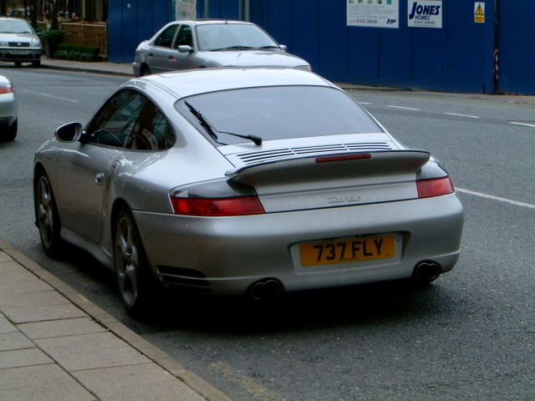

Resolution: How Much Is Enough? (cont…)
The picture on the right is fine for counting the number of cars, but not for reading the number plate

Slide 82

Intensity Level Resolution (cont…)
Low Detail
Medium Detail
High Detail
Huang Experiment [1965] attempt to quantify experimentally the effects on image quality produced by varying N and k simultaneously.

Slide 83

Intensity Level Resolution (cont…)
Isopreference curves tend to become more vertical as the detail in the image increase.
As the detail in the image decrease the perceived quality remained the same in some intervals in which the spatial resolution was increased, but the number of gray levels actually decreased.
A possible explanation is that a decrease in k tends to increase the apparent contrast of an image, a visual effect that human often perceive as improved quality in an image.

Slide 84
Basic Relationship of Pixels
(0,0)
x
(x-1,y-1)
(x,y-1)
(x+1,y-1)
(x-1,y)
(x,y)
(x+1,y)
f(x,y) is the reference pixel
y
(x-1,y+1)
(x,y+1)
(x+1,y+1)
Conventional indexing method

Slide 85
Neighbors of a Pixel
Neighborhood relation is used to tell adjacent pixels. It is
useful for analyzing regions.
4-neighbors of p:
(x,y-1)
(x−1,y)
(x+1,y)
(x,y−1)
(x,y+1)
(x-1,y)
p
(x+1,y)
N₄(p) =
(x,y+1)
4-neighborhood relation considers only vertical and
horizontal neighbors.
Note: q ∈ N₄(p) implies p ∈ N₄(q)

Slide 86
Neighbors of a Pixel (cont.)
8-neighbors of p:
(x-1,y-1)
(x,y-1)
(x+1,y-1)
(x−1,y−1)
(x,y−1)
(x+1,y−1)
(x−1,y)
(x+1,y)
(x−1,y+1)
(x,y+1)
(x+1,y+1)
(x-1,y)
p
(x+1,y)
(x-1,y+1)
(x,y+1)
(x+1,y+1)
N₈(p) =
8-neighborhood relation considers all neighbor pixels.

Slide 87
Neighbors of a Pixel (cont.)
Diagonal neighbors of p:
(x-1,y-1)
(x+1,y-1)
(x−1,y−1)
(x+1,y−1)
(x−1,y+1)
(x+1,y+1)
p
N_{D}(p) =
(x-1,y+1)
(x+1,y+1)
Diagonal -neighborhood relation considers only diagonal
neighbor pixels.

Slide 88

Connectivity
Connectivity is adapted from neighborhood relation.
Two pixels are connected if they are in the same class (i.e. the
same color or the same range of intensity) and they are
neighbors of one another.
For p and q from the same class
w 4-connectivity: p and q are 4-connected if q Î N₄(p)
w 8-connectivity: p and q are 8-connected if q Î N₈(p)
w mixed-connectivity (m-connectivity):
p and q are m-connected if q Î N₄(p) or
q Î N_{D}(p) and N₄(p) Ç N₄(q) = Æ

Slide 89
Adjacency
A pixel p is adjacent to pixel q if they are connected.
Two image subsets (or regions) S₁ and S₂ are adjacent if at least one pixel in S₁ is connected to some pixel in S₂
S₁
S₂
We can define type of adjacency: 4-adjacency, 8-adjacency
or m-adjacency depending on type of connectivity.

Slide 90
Path
A path from pixel p at (x,y) to pixel q at (s,t) is a sequence
of distinct pixels:
(x₀,y₀), (x₁,y₁), (x₂,y₂),…, (x_{n},y_{n})
such that
(x₀,y₀) = (x,y) and (x_{n},y_{n}) = (s,t)
and
(x_{i},y_{i}) is connected to (x_{i-1},y_{i-1}), i = 1,…,n
e.g.,
q
p
We can define type of path: 4-path, 8-path or m-path
depending on type of connectivity.

Slide 91
Path (cont.)
8-path
m-path
p
p
p
q
q
q
m-path from p to q
solves this ambiguity
8-path from p to q
results in some ambiguity
w Recall mixed-connectivity (m-connectivity):
p and q are m-connected if q ∈ N₄(p) or
q ∈ N_{D}(p) and N₄(p) ∩ N₄(q) = ∅

Slide 92
Distance
For pixel p, q, and z with coordinates (x,y), (s,t) and (u,v),
D is a distance function or metric if
w D(p,q) ≥ 0 (D(p,q) = 0 if and only if p = q)
w D(p,q) = D(q,p)
w D(p,z) ≤ D(p,q) + D(q,z)
Example: Euclidean distance

Slide 93
Arithmetic Operations
Array operations between images
Carried out between corresponding pixel pairs
Four arithmetic
s(x, y) = f(x, y) + g(x, y)
d(x, y) = f(x, y) – g(x, y)
p(x, y) = f(x, y) × g(x, y)
v(x, y) = f(x, y) ÷ g(x, y)
e.g. Averaging K different noisy images can decrease noise
Used in the field of astronomy

Slide 94

Averaging K different noisy images can decrease noise. Used in astronomy

Slide 95


Enhancement of difference between images using image subtraction

Slide 96


Mask mode radiography- Image Subtraction

Slide 97

Shading correction by image multiplication (and division)

Slide 98

Masking (ROI) using image multiplication

Slide 99
Arithmetic Operations
To guarantee that the full range of an arithmetic operation between images is captured into a fixed number of bits, the following approach is performed on image f
f_{m} = f – min(f)
which creates an image whose minimum value is 0. Then the scaled image is
f_{s} = K [ f_{m} / max(f_{m})]
whose value is in the range [0, K]

Slide 100
Set and Logical Operations
Sets can be used to represent the regions of an image i.e., elements of sets be the coordinates of pixels (ordered pairs of integers) representing regions (objects) in an image
Union
Intersection
Complement
Difference
Logical operations
OR
AND
NOT
XOR

Slide 101
Set Operations on images are unconventional
Notes:
AND is Intersection (for grayscale pick the minimum)
OR is Union (for grayscale pick the maximum)
A’ is 255-r

Slide 102

Application of Set Operations

Slide 103

Logical Operations on Images (binary images only)

Slide 104

Image Interpolation
Using known data to estimate values at unknown locations
Used for zooming, shrinking, rotating, and geometric corrections
Nearest Neighbor interpolation
Use closest pixel to estimate the intensity
simple but has tendency to produce artifact
Bilinear interpolation
use 4 nearest neighbor to estimate the intensity
Much better result
Bicubic interpolation
Use 16 nearest neighbors of a point

Slide 105


Interpolation works by using known data to estimate values at unknown points.
For example: if you wanted to know the temperature at noon, but only measured it at 11AM and 1PM, you could estimate its value by performing a linear interpolation:
If you had an additional measurement at 11:30AM, you could see that the bulk of the temperature rise occurred before noon, and could use this additional data point to perform a quadratic interpolation:

Slide 106

The more temperature measurements you have which are close to noon, the more sophisticated (and hopefully more accurate) your interpolation algorithm can be.

Slide 107

1. NEAREST NEIGHBOR INTERPOLATION
Nearest neighbor is the most basic and requires the least processing time of all the interpolation algorithms because it only considers one pixel — the closest one to the interpolated point. This has the effect of simply making each pixel bigger.

Slide 108

2. BILINEAR INTERPOLATION
Bilinear interpolation considers the closest 2x2 neighborhood of known pixel values surrounding the unknown pixel. It then takes a weighted average of these 4 pixels to arrive at its final interpolated value.
This results in much smoother looking images than nearest neighbor.
The diagram to the left is for a case when all known pixel distances are equal, so the interpolated value is simply their sum divided by four.
OR

Slide 109
3. BICUBIC INTERPOLATION
Bicubic goes one step beyond bilinear by considering the closest 4x4 neighborhood of known pixels — for a total of 16 pixels.
Since these are at various distances from the unknown pixel, closer pixels are given a higher weighting in the calculation.
Bicubic produces noticeably sharper images than the previous two methods, and is perhaps the ideal combination of processing time and output quality.
For this reason it is a standard in many image editing programs (including Adobe Photoshop), printer drivers and in-camera interpolation.

Slide 110

The intensity value assigned to point (x,y) is obtained by equation where the sixteen coefficients are determined from the sixteen equations in sixteen unknowns that can be written using the sixteen nearest neighbours of point (x,y)

Slide 111


Slide 112
Spatial Operations
Single-pixel operations
For example, transformation to obtain the negative of an 8-bit image
Operations ( also called transformations) that are performed on pixels. They are of three types:
S = T (z)

Slide 113


Slide 114
Spatial Operations
Neighborhood operations
For example, compute the average value of the pixels in a rectangular neighborhood of size m × n centered on (x, y)

Slide 115



Slide 116
Spatial Operations
Geometric spatial transformations
Called rubber-sheet transformations
Consists of two operations
Spatial transformation of coordinates
e.g. (x, y) = T { ( v, w) } = ( v/2, w/2)
Affine transform: scale, rotate, transform, or sheer a set of points
Intensity interpolation

Slide 118


Slide 119


Slide 120
Image Transforms
Image processing tasks are best formulated by
Transforming the images to another domain
Carrying the specified task in a transform domain
Applying the inverse transform

Slide 121


Slide 122


